Slide 1
Recommendation Where to Open a Restaurant in Downtown Toronto
IBM Data Science Professional Certificate
P R E S E N T E D B Y:
ADIB Zefar
May 9 ^{TH}, 2019

Slide 2
6 Steps of Data Analytics
Problem Definition
Data Pre-processing
Exploratory Data Analysis
Modelling
Conclusion
Future Work/Deployment
1
2
3
4
5
6
6
2

Slide 3
1- Problem Definition
Finding the best location to open a South Asian Restaurant in Downtown Toronto
The data is from Wikipedia: https://en.wikipedia.org/wiki/List_of_postal_codes_of_Canada:_M
The geographical coordinates of each postal code in Toronto can found here: https://cocl.us/Geospatial_data
1 Problem Definition
2 Data Preparation
3 Data Exploration
4 Modelling
5 Evaluation
6 Deployment

Slide 4
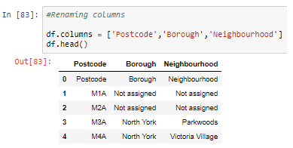
2- Data Wrangling/Cleaning
The columns in the data frame had default column name (i.e. 0, 1, 3) so there name are changed to Postcode, Borough and Neighborhood.
1 Problem Definition
2 Data Preparation
3 Data Exploration
4 Modelling
5 Evaluation
6 Deployment

Slide 5
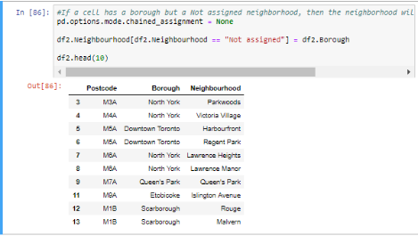
2- Data Wrangling/Cleaning
If a cell has a borough but a not assigned neighborhood, then the neighborhood will be the same as the borough.
1 Problem Definition
2 Data Preparation
3 Data Exploration
4 Modelling
5 Evaluation
6 Deployment

Slide 6
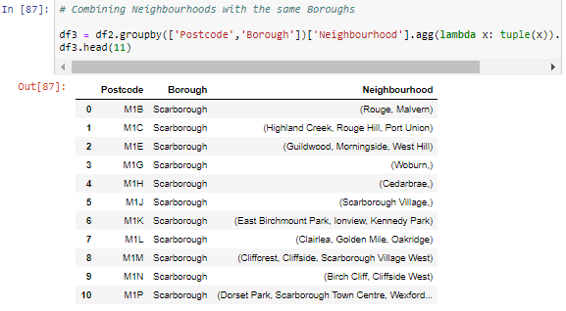
2- Data Wrangling/Cleaning
Neighborhoods that exist in one postal code area will combined into one row with neigborhoods separated with commas.¶
1 Problem Definition
2 Data Preparation
3 Data Exploration
4 Modelling
5 Evaluation
6 Deployment

Slide 7
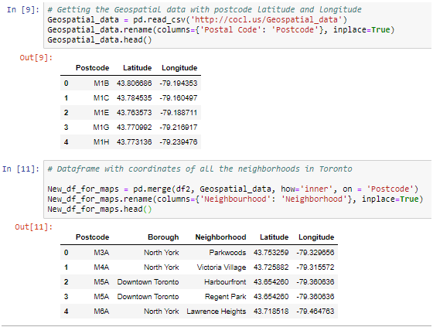
2- Data Wrangling/Cleaning
The geospatial data with the coordinates of all the postcode in Toronto will be merged with the previous dataframe 'df3' to form a new dataframe 'New_df_for_maps'.
1 Problem Definition
2 Data Preparation
3 Data Exploration
4 Modelling
5 Evaluation
6 Deployment

Slide 8
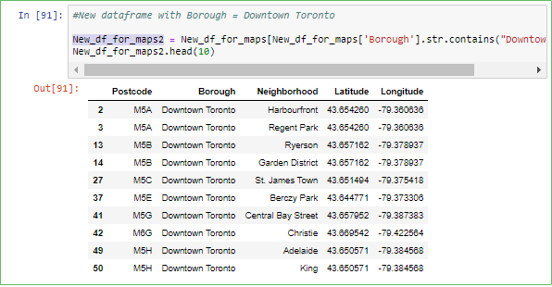
2- Data Wrangling/Cleaning
We would like open a restaurant in Downtown Toronto. Hence, a new dataframe 'New_df_for_maps2' will be created to explore Downtown Toronto only.
1 Problem Definition
2 Data Preparation
3 Data Exploration
4 Modelling
5 Evaluation
6 Deployment

Slide 9
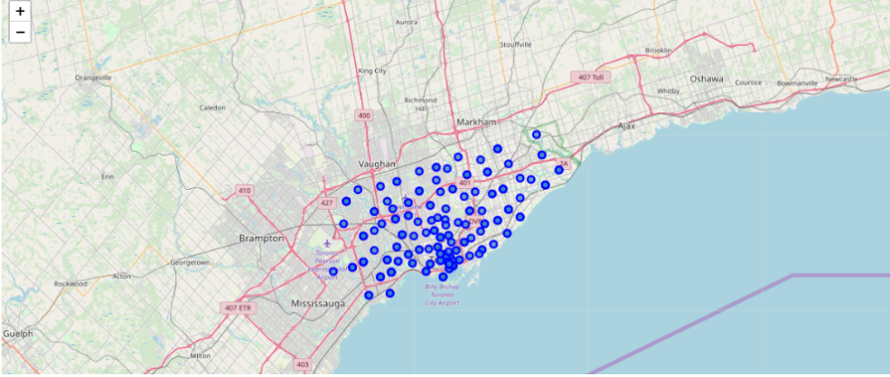
3- Exploratory Data Analysis
Map of Toronto with neigborhoods superimposed on top.
Figure 1: The blue dots in the above map represent the different neighborhoods in Toronto.
1 Problem Definition
2 Data Preparation
3 Data Exploration
4 Modelling
5 Evaluation
6 Deployment

Slide 10
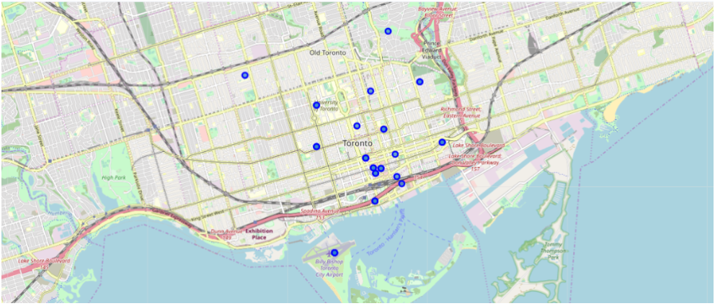
3- Exploratory Data Analysis
Visualizing only the neighborhoods in Downtown Toronto.
Figure 2: The blue dots in the above map represent the different neighborhoods in Downtown Toronto.
1 Problem Definition
2 Data Preparation
3 Data Exploration
4 Modelling
5 Evaluation
6 Deployment

Slide 11
4 – Modelling
K-Mean Clustering
3 Data Exploration
4 Modelling
5 Evaluation
6 Deployment

Slide 12
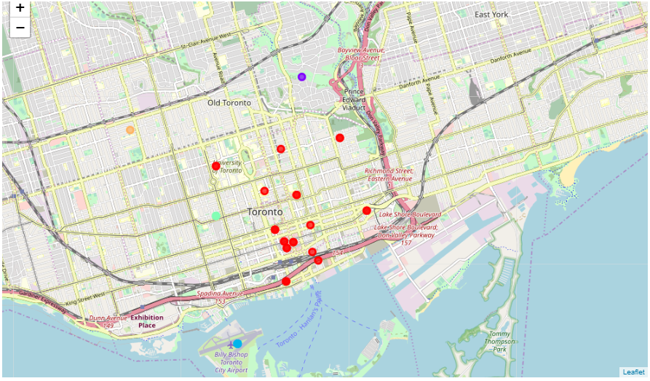
4 – K-Means Clustering – Visualizing Clusters
Figure 3: The colour of the dots are as follows: red is cluster 0, purple is cluster 1, light blue is cluster 2, light green is cluster 3 and orange is cluster 4.¶
3 Data Exploration
4 Modelling
5 Evaluation
6 Deployment

Slide 13
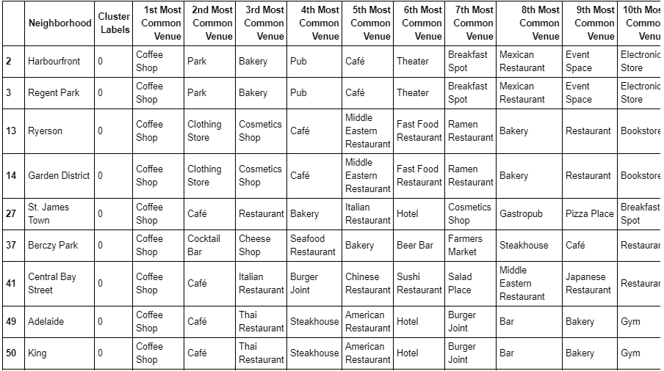
4 – K-Means Clustering – Examining Clusters
Cluster 0 has the most number of neigborhoods and mostly contain coffee shops and cafes.
3 Data Exploration
4 Modelling
5 Evaluation
6 Deployment

Slide 14
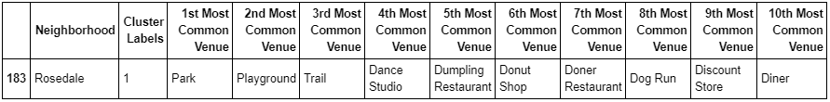
4 – K-Means Clustering – Examining Clusters
Cluster 1 only has one neighborhood and contains mostly park, playgrounds, trails, etc.
3 Data Exploration
4 Modelling
5 Evaluation
6 Deployment

Slide 15
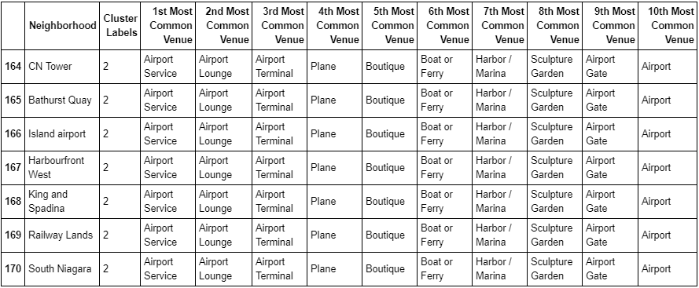
4 – K-Means Clustering – Examining Clusters
Cluster 2 has the second most number of neigborhoods. It mostly has venues related to airport in Downtown Toronto.
3 Data Exploration
4 Modelling
5 Evaluation
6 Deployment

Slide 16
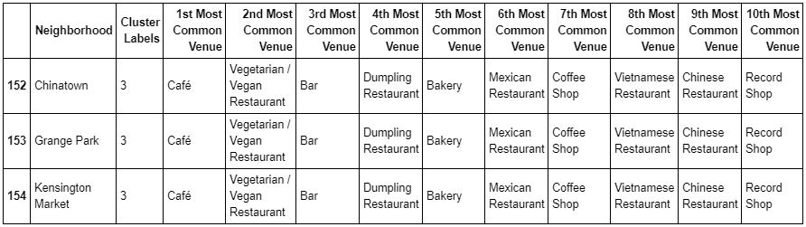
4 – K-Means Clustering – Examining Clusters
Cluster 3 has three neighborhoods. Cluster 3 mostly has restaurants and mahjority of them are South Asian Restaurants.
3 Data Exploration
4 Modelling
5 Evaluation
6 Deployment

Slide 17
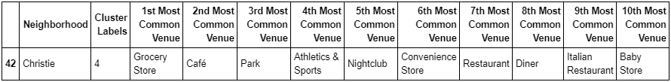
4 – K-Means Clustering – Examining Clusters
Cluster 4 only has one neighborhood and contains Grocery and convenience stores.
3 Data Exploration
4 Modelling
5 Evaluation
6 Deployment

Slide 18
5 –Discussion
37 neigboirhoods and 204 unique venues in Downtown Toronto
K-Means Clustering was used to partition the data into 5 clusters:
Coffee Shops
Parks
Airport Services
Restaurants
Grocery Stores
Cluster 3 is the ideal location to open a South Asian Restaurant
Any of the three locations from Chinatown, Grange Park to Kensington Market would be the best location for our restaurant
Further analysis such as real estate price, rent, restaurant demand should be taken into consideration prior to making final decision on selecting the location.
1 Problem Definition
2 Data Preparation
3 Data Exploration
4 Modelling
5 Discussion
6 Deployment

Slide 19
6 – Conclusion
Geolocation data from Wikipedia and the geographical coordinates of each postal code in Toronto were used to recommend the ideal location to open a South Asian Restaurant in Downtown Toronto
K-Means Clustering was used to partition the data into 5 clusters; Coffee Shops, Parks, Airport services, Restaurants and Grocery Stores
The restaurant cluster have three neighborhoods: Chinatown, Grange Park and Kensington Market.
All three locations have the same top ten most common venues which mostly contain South Asian restaurants
Recommendation is to open the South Asian Restaurant in one of the three locations depending on real estate price/rent and the demand of the niche South Asian restaurant you would like to open
1 Problem Definition
2 Data Preparation
3 Data Exploration
4 Modelling
6 Conclusion
7 Deployment

Slide 20
6 – Deployment/Future Work
Other unsupervised learning methods such as partitioning, hierarchical or density-based clustering should be used in comparing their performance in K-Means Clustering.
Different cluster values should be used to determine the optimal number of clusters to reduce error and come up with more accurate recommendation
1 Problem Definition
2 Data Preparation
3 Data Exploration
4 Modelling
5 Evaluation
6 Future Work
5 Conclusion

